Slide 1

Signs with Smart Connectivity for Better Road Safety
ADHIYAMAAN COLLEGE OF ENGINEERING
(AUTONOMOUS) ,HOSUR
DEPARTMENT OF COMPUTER SCIENCE AND ENGINEERING
Team-id:PNT2022TMID08042
TEAM MEMBERS:
Swithin Asir S - AC19UCS125
Sneha P - AC19UCS109
Swapna V - AC19UCS123
Thejeshkumar S - AC19UCS129
GUIDED BY:
Mrs.B.Revathi M.E
AP/ CSE

Slide 2
ABSTRACT
In present system the road signs and the speed limits are static.
But the road signs can be changed in some cases.
This project proposes a system which has digital sign boards on which the signs can be changed dynamically.
If there is rainfall then the roads will be slippery and the speed limit would be decreased.
There is a web app through which you can report of the road diversion ,accident areas and information sign boards can be entered through web app.
This data is retrieved and displayed on the sign boards accordingly

Slide 3
Objective
The main objective of our project is to reduce the speed the speed limit of the vehicles
By using the weather API we will change the speed limit in the sign board according to the current weather.
We will generate the fine who are crossing the speed limit in digital sign board
By using this sign board we will avoid the unwanted noise from the vehicles

Slide 4
LITERATURE SURVEY
S.No | Title | Proposed Work | Tools Used / Algorithm | Technology
1. | Smart Board | The connection between Android and Smart Board uses Wi-Fi connection. Android application used to send Notices | •Arduino •Wi-Fi | •PHP •Node MCU

Slide 5
S.No | Title | Proposed Work | Tools Used / Algorithm | Technology
2 | Smart Multilingual Sign Boards | Implementation of smart hybrid system for street sign boards recognition, text and speech conversions through character extraction and symbol matching. | •Street Sign Boards Recognition, •Character Extraction •Symbol Matching | •Computer Vision •GCP

Slide 6
S.No | Title | Proposed Work | Tools Used / Algorithm | Technology
3 | A Smart Notice Board System Using IoT Technology | Will enable people to wireless transmit notices on a notice board using GSM with smart Phone and users get auto notification using parse cloud. | •Microcontroller ATMEGA 328 Programmed in C language. | •GSM Module, • P10 LED Display, •Smart Phoneud, •IoT (Internet of Things)

Slide 7
S.No | Title | Proposed Work | Tools Used / Algorithm | Technology
4 | GSM based Smart home and digital notice board | The message can be sent through an android application designed in this project, to the GSM SIM900 module | •GSM technology for communication •To sends SMS | •microcontroller LPC2148, •GSM SIM900 module, •An LCD, •A motor •An android application

Slide 8
S.No | Title | Proposed Work | Tools Used / Algorithm | Technology
5 | Digital Notice Board Based on IOT | To provide its users with a simple, fast and reliable way to put up important notices in an LED where the user can send a message to be displayed in the LED. | •Speech to Text •Google Assistant | •IOT •LED Matrix •Arduino

Slide 9
EXISTING SYSTEM
A traffic sign board (TSB) informs drivers in advance of impending road conditions and may also contain instructions, warnings, or counselling.
The drivers are expected to be aware of the sign board in typical TSBs, which use sign boards as a signal for cars.
Rain, a traffic gridlock, high light levels, and high vehicle speeds are among conditions that impair the sight of the TSBs. Consequently, a Bluetooth Low Energy-based smart traffic sign system (BLE).
By employing BLE, the system strategically informs road users (such as drivers, passengers, and riders) about the TSB.

Slide 10
DISADVANTAGES
All travellers have access on an equal basis as others which includes areas such as transportation and employment.
People's perceptions of what it's like to live with a disability is one of the most foundational barriers.
Discrimination and prejudice are some of attitudes that can make it difcult for a disability to be able to participate in everyday life.
Inability to move without assistance was the most common disability.

Slide 11
PROPOSED SOLUTION
In this project,an assistive sign board with smart connectivity for better road safety .
To replace the static signboard , smart connected sign board are used.
These smart connectivity sign boards get the speed limitation from a web app using weather API and update automatically.
Based on the weather changes the speed may increase or decrease.
Based on the traffic and fatal situations the diversion signs are displayed.
Guide(Schools),warning and service(Hospitals,Restaurant)signs are also displayed accordingly.

Slide 12
ADVANTAGES
It help to providing a continuous movement of traffic at a certain speed in a given route or way.
It help to reducing the frequency of variety type of accidents.
It increases the traffic handling capacity of a certain intersection.

Slide 13
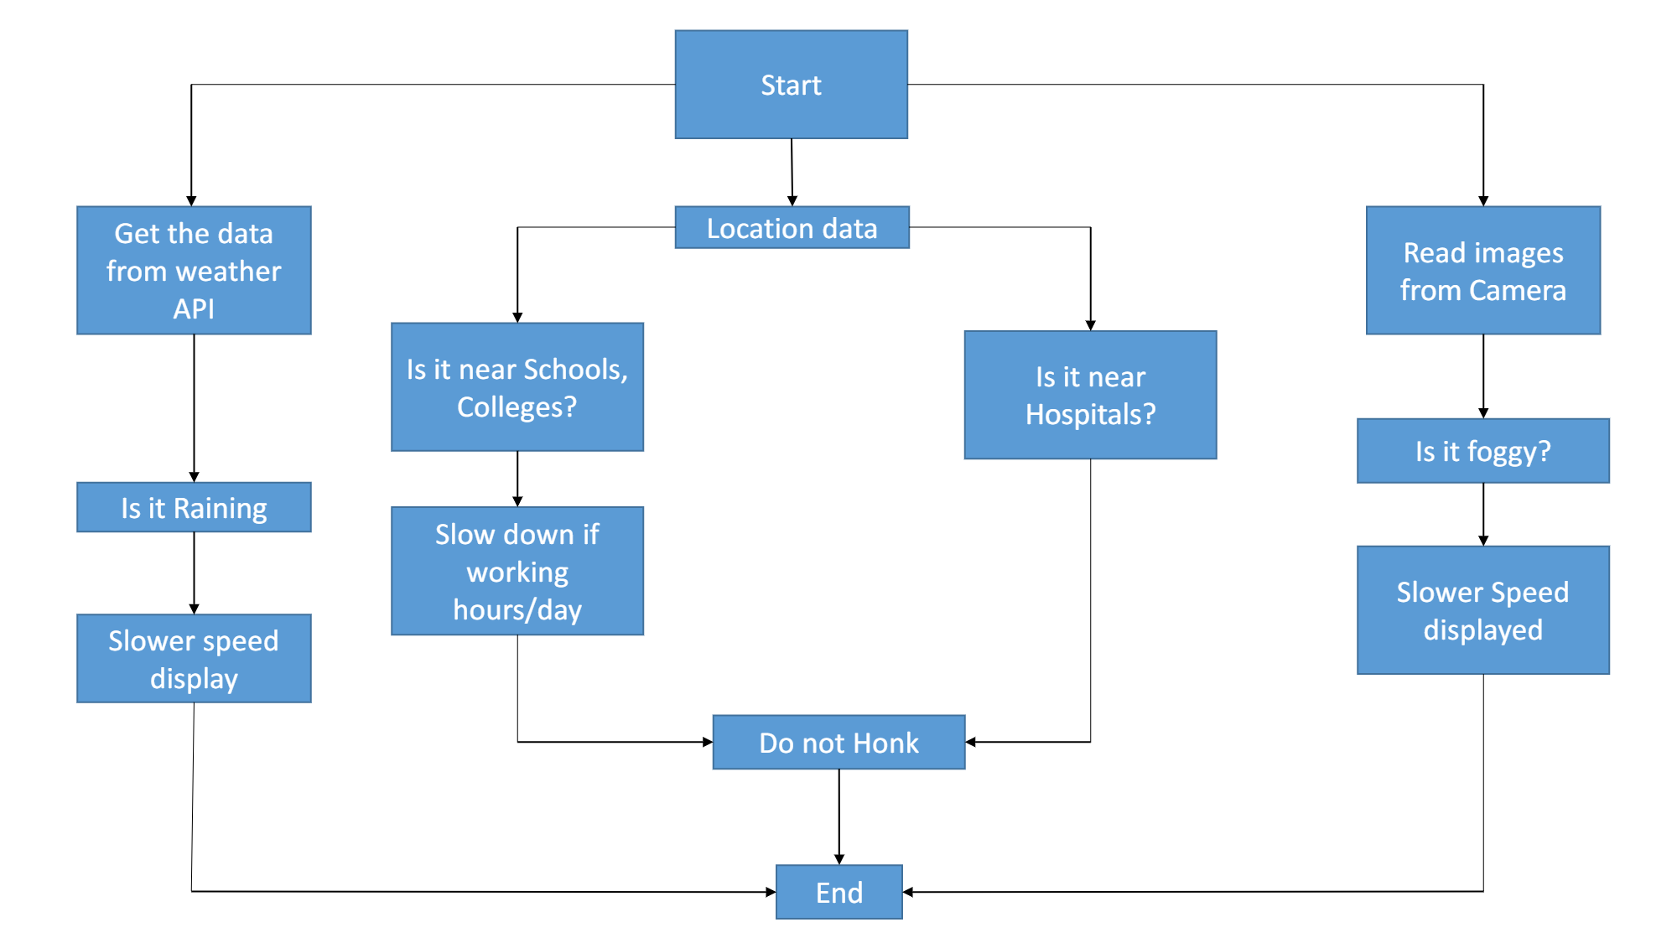
SOLUTION ARCHITECTURE:

Slide 14
MODULES:
Collecting the weather details
Collecting the car no
Dashboard
Fine generation

Slide 15
COLLECTING THE WEATHER DETAILS:

Slide 16
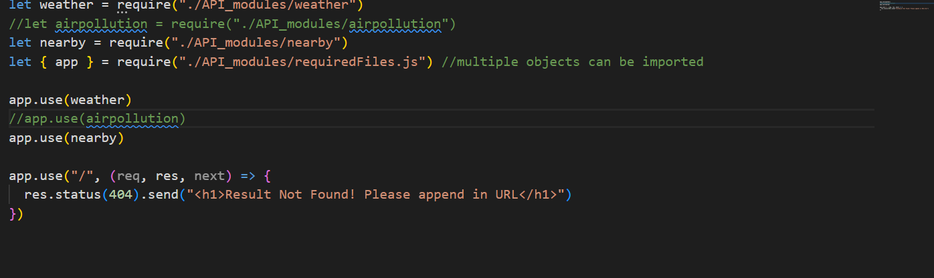
CODE:

Slide 17
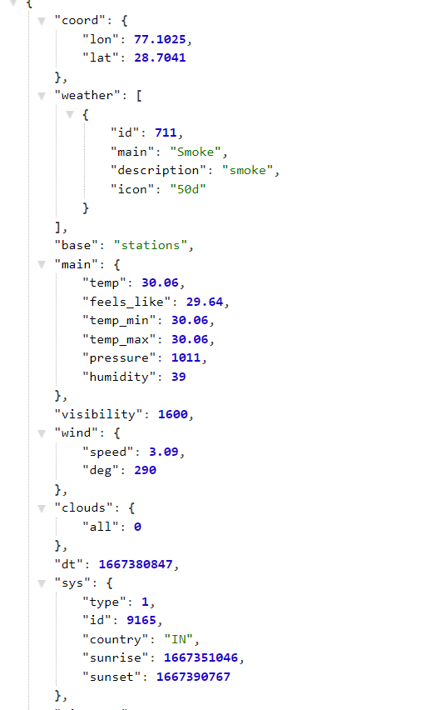
OUTPUT:

Slide 18
COLLECTING THE CAR NO:

Slide 19
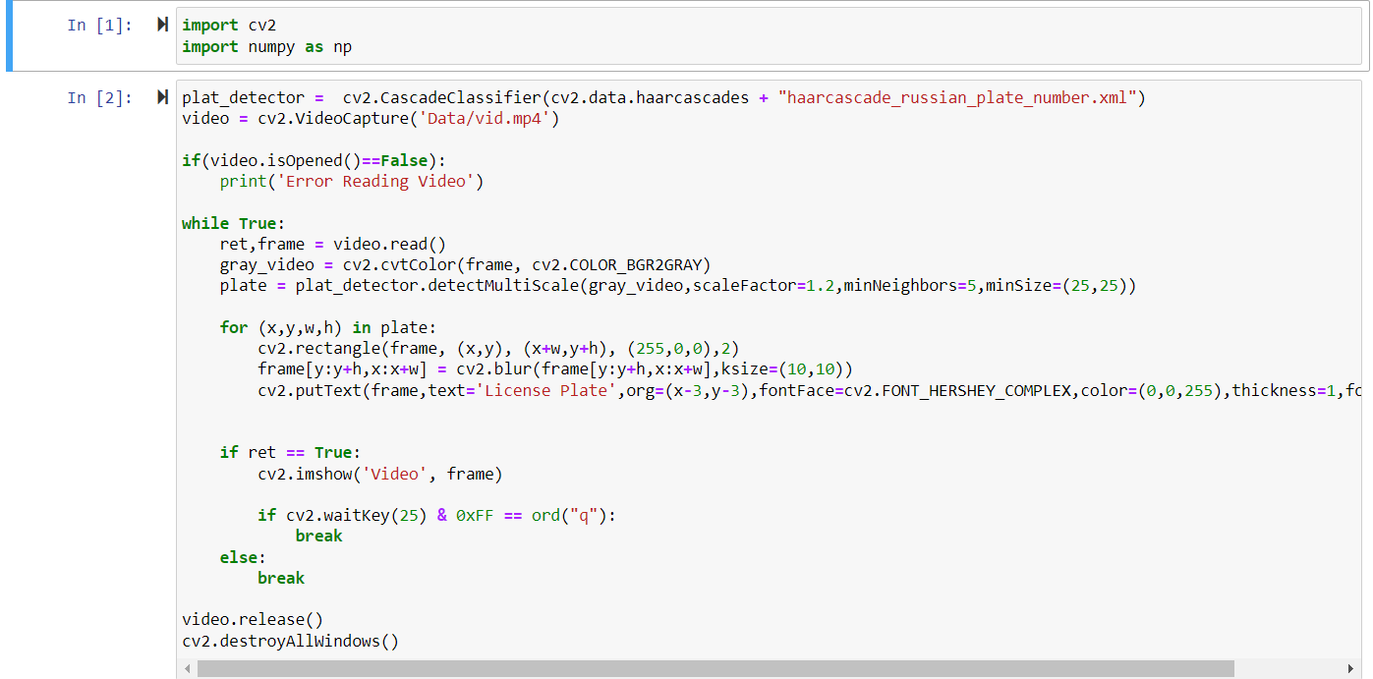
CODE:

Slide 20
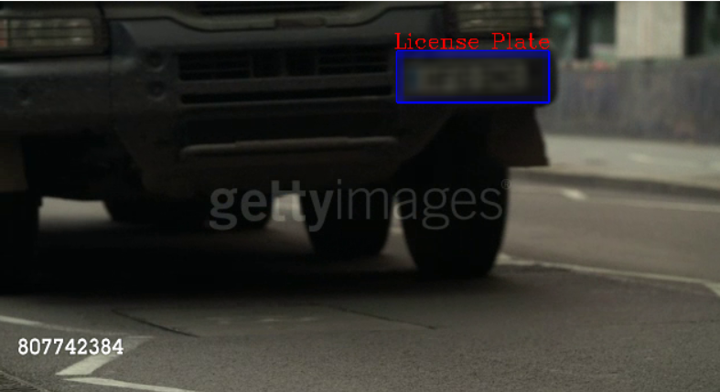
OUTPUT:

Slide 21
DASHBOARD

Slide 22
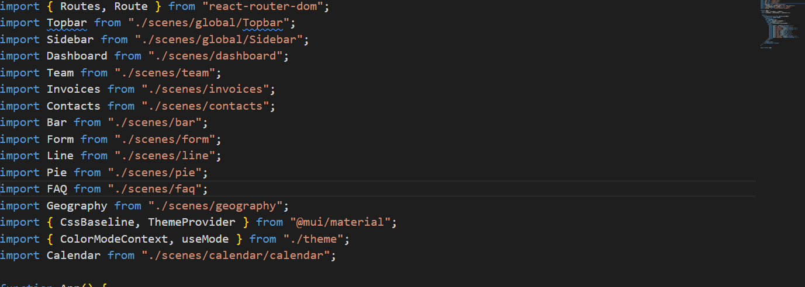
CODE:

Slide 23
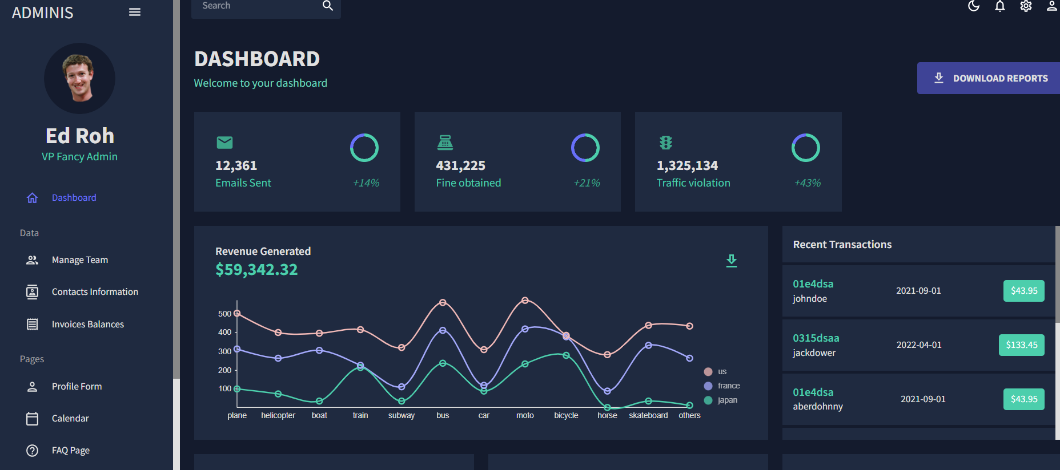
OUTPUT:

Slide 24
CONCLUSION:
By using this we can give the safety for the people who are using roads for the travelling
FUTURE SCOPE:
In Future we can give access for finding the safety wears like helmet, car seat belt ect

Slide 25
Reference:
https://www.researchgate.net/publication/328130229_Smart_Board
https://www.researchgate.net/publication/305365822_Poster_A_Step_Towards_Smart_Traffic_Sign_Board_by_Smart_Devices
https://www.researchgate.net/publication/336355855_Smart_Traffic_Sign_Boards_STSB_for_Smart_Cities
https://careereducation.smartinternz.com/saas-guided-project/3/signs-with-smart-connectivity-for-better-road-safety

